Slide 1



CAPSTONE PROJECT
Engineering Student Placement Analytics Dashboard
Presented By
Student Name: Thikari vignesh
College Name: matrusri engineering college
Department: CSe-Data science
Email ID: vigneshthikari@gmail.com

Slide 2
OUTLINE:
Problem Statement (Should not include solution)
Proposed System/Solution
System Development Approach (Technology Used)
Algorithm & Deployment
Result (Output Image)
Conclusion
Future Scope
References

Slide 3
Problem Statement:
Engineering colleges produce thousands of graduates every year, but not all students secure placements. Many factors such as academic performance, technical skills, internships, hackathon participation, and backlogs influence employability. However, institutions often lack a data-driven approach to analyze these factors and identify which students are most likely to be placed.Without proper analytics, it becomes difficult for colleges to understand skill gaps, improve training programs, and increase placement success rates.

Slide 4
Proposed Solution:
The proposed solution is a data analytics dashboard developed using Power BI and Python that evaluates engineering students’ employability based on academic performance, skills, and practical experience.
The system processes the dataset and calculates key metrics such as skill score, internship experience, and academic performance. Based on these factors, a placement indicator column is generated to identify whether a student is likely to be placed.
The dashboard then visualizes this information using interactive charts, KPIs, and analytical insights to help institutions understand placement trends and factors influencing employability.

Slide 5
System Approach:
Data Analysis Libraries
Pandas – Data manipulation and preprocessing
NumPy – Numerical computations
Data Visualization
Microsoft Power BI
Dataset Format
CSV (Comma Separated Values)
Development Tools
Google Colab Notebook
Power BI Desktop

Slide 6
Algorithm & Deployment:
Load the dataset containing student academic and skill details.
Calculate the average values for key parameters including: Tenth percentage , Twelfth percentage , CGPA , Backlogs , Internships completed , Hackathons participated
Compute an average score for each student using these parameters.
Compare each student's score with the dataset average.
If the student’s score is greater than or equal to the average, mark the student as “Placed”, otherwise mark as “No”.
Store the results in a new column called Placed.
Use Power BI to visualize placement patterns and insights.

Slide 7
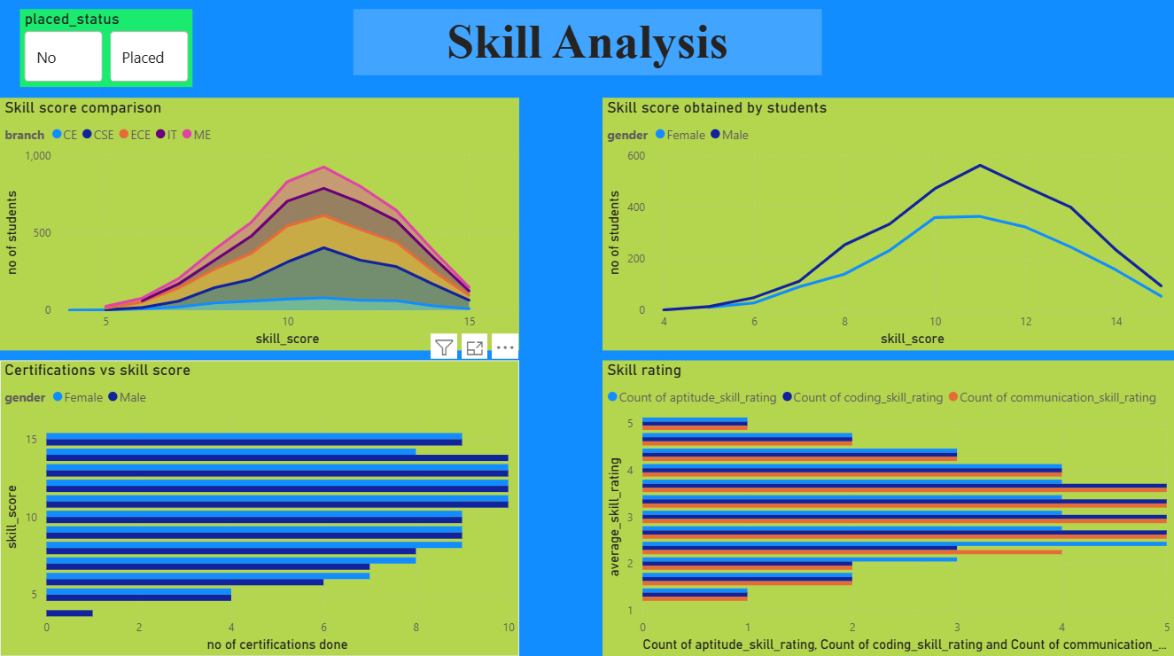
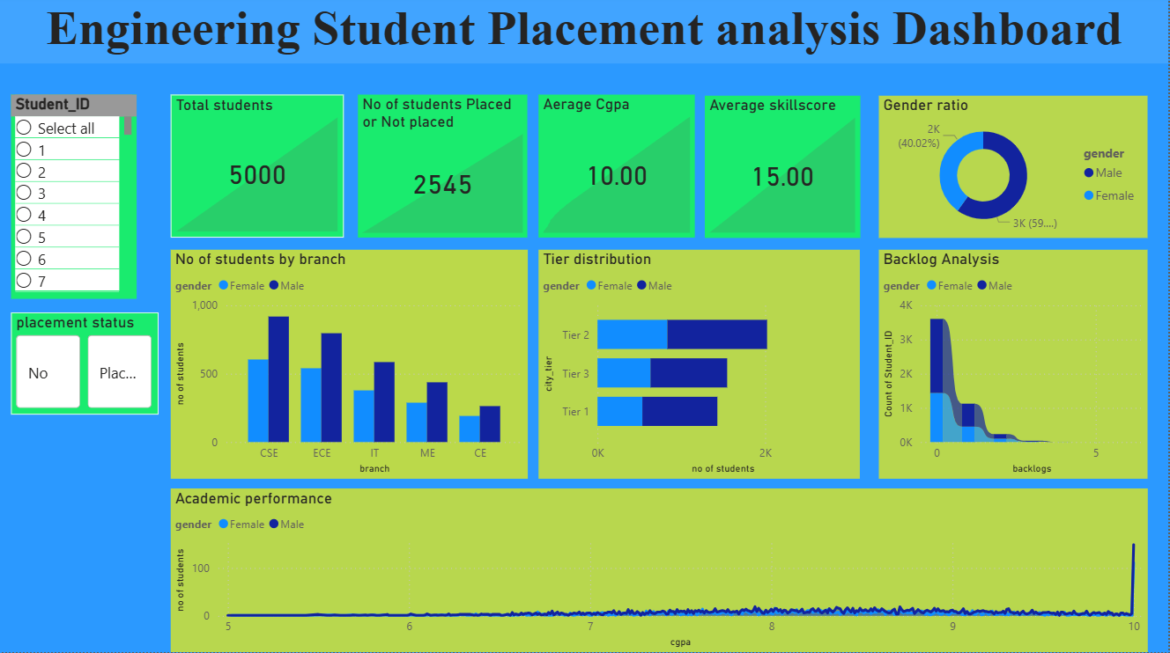
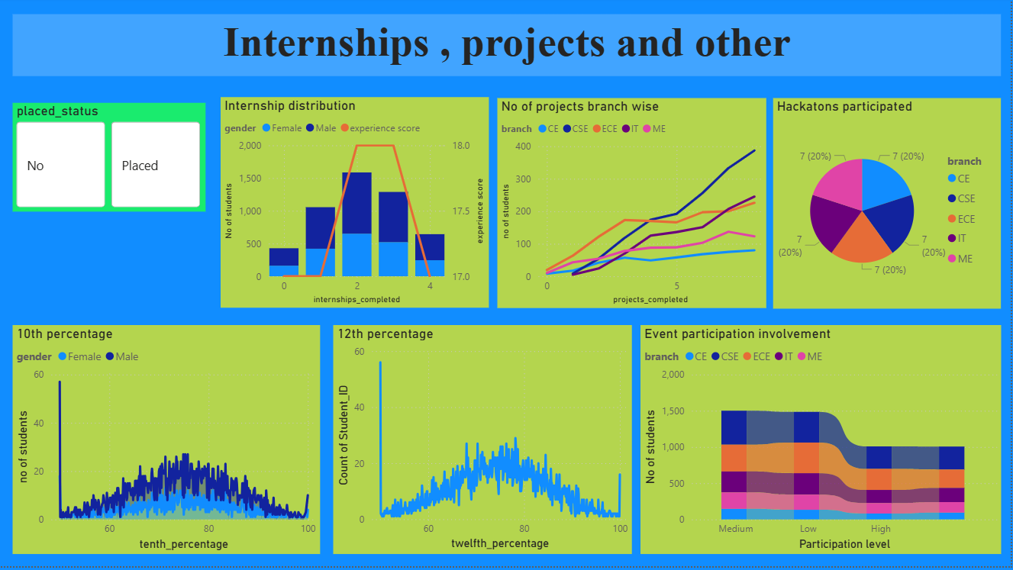
Result:
The system successfully analyzed the student dataset and generated meaningful insights regarding employability.
Key results obtained include:
Identification of students in college.
Analysis of internships, hackathons, and academic performance on placements.
Skill score analysis

Slide 8
Conclusion:
The project demonstrates how data analytics can be used to evaluate engineering students’ employability and identify factors that influence placement success. By analyzing academic performance, skills, and practical exposure, the system provides valuable insights that help institutions improve training programs and placement strategies.
The interactive dashboard enables stakeholders to quickly understand student performance patterns and identify areas where students need improvement. Overall, the system helps bridge the gap between academic education and industry requirements.

Slide 9
Future scope:
The system can be further improved with several enhancements:
Integration of machine learning models to predict placement probability more accurately.
Addition of real-time student performance tracking.
Development of a web-based dashboard accessible to students and faculty.
Incorporation of resume analysis and interview performance data.
Use of AI-driven career recommendation systems to guide students toward suitable job roles.
These improvements would make the system more intelligent and useful for placement planning.

Slide 10
References:
GitHub Link:
https://github.com/Vignesh-op/Engineering-Student-Placement-Analytics-Dashboard
Dataset Link:
https://www.kaggle.com/datasets/thikarivignesh/engineering-student-placement-analytics
Research paper:
https://www.mecs-press.org/ijeme/ijeme-v15-n1/v15n1-2.html

Slide 11
Thank You

